Slide 1
Lecture 2: Specification and Design By Contract
EC3307:Object & Component Technology

Slide 2
Overview
Specification Vs Code
Precondition
Postcondition
Invariant
Design By Contract

Slide 3
Specification versus ‘code’
Reading ‘code’ is tedious and time-consuming*
We should decide what we are going to do before we do it:
We should specify before we program
* Microsoft Word™ is 2½ million lines of C++

Slide 4
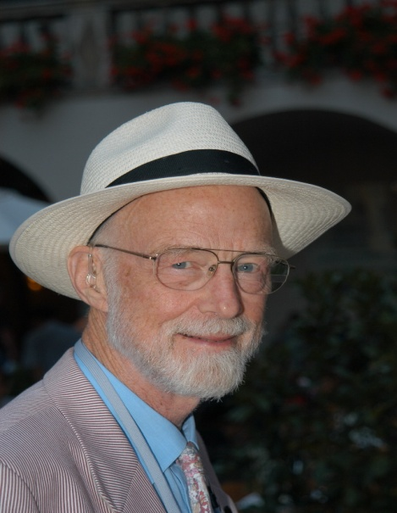
Professor Sir C. A. R. (Tony) Hoare
Formerly Head of Programming Research Group (PRG), Oxford University, England
Microsoft Research, Cambridge, England
Hoare, C.A.R.: An axiomatic basis for computer programming. Communications of the ACM 12 (1969) 576-580
[WH66] N. Wirth and C. A. R. Hoare. A contribution to the development of Algol. Comm. ACM, 9(6):413-432, June 1966

Slide 5
Specification
Say what we want to do – not how we do it
Hoare’s approach:
Determine necessary properties of the state before some operation: the operation’s pre-condition
Determine necessary properties of the state after the operation: its post-condition
State: the values of all the relevant variables, files …

Slide 6
What are Preconditions and Postconditions?
One way to specify function requirements is with a pair of statements about the function.
The precondition statement indicates what must be true before the function is called.
The postcondition statement indicates what will be true when the function finishes its work.

Slide 7
Pre-condition
A pre-condition is a Boolean expression that describes the state that the variables of the program (or program fragment) must be in for the program to be able to work correctly.
Example: the pre-condition of a program to find the square-root of x is:
x >= 0
since negative numbers do not have (real) square-roots.

Slide 8
Pre-condition: TRUE
A pre-condition of TRUE means there is no pre-condition.
(It works whenever TRUE is true)

Slide 9
Pre-condition: FALSE
A pre-condition of FALSE would specify a program that never works.
(It only works when FALSE is true)
We try to avoid writing programs that have FALSE as pre-condition!

Slide 10
Post-condition
A post-condition gives a state that should be true when the program has finished.
Example:
sqrtx * sqrtx ≈ x
The result of the square-root operation sqrtx, multiplied by itself should be (approximately) equal to x

Slide 11
Specifying with pre-+ and post
We abbreviate pre-condition to pre
We abbreviate post-condition to post
And specify a program as follows:
(* pre *)
program
(* post *)
Meaning: Executing program when pre is true leaves post true

Slide 12
Example

Slide 13
Pre-condition not satisfied?
Which of these function calls meet the precondition ?
write_sqrt( -10 );
write_sqrt( 0 );
write_sqrt( 5.6 );

Slide 14
Pre-condition not satisfied?
The Hoare style of specification intentionally says nothing about what will happen if the pre-condition is not true – not satisfied – when the operation is used.

Slide 15
Everyday example
The owner’s manual for my car says that it should operate correctly when the air temperature is –10°C or more.
This is a pre-condition of the car’s successful use.

Slide 16
Everyday example
If the temperature falls below –10°C, there is no guarantee what will happen:
the car might fail to work
it might be damaged
it might even work normally.
In all cases, the car’s behaviour will be deemed to have satisfied its specification.

Slide 17
My first, American-model, Macintosh
On the back, above the power socket:
‘110’
It expects 110 volts (US).
I give it 240 volts (UK).
What happens?
What is the pre-condition?
Who is responsible?

Slide 18
Specifying with pre- and post
Example:
(* TRUE *)
Add
(* z = x + y *)

Slide 19
Specifying with pre- and post
Pascal:
PROCEDURE Heading(parameters);
(* pre: what is required
post: what will be true afterwards *)
Note: I prefer to put the procedure’s heading before the specification. Some people put the specification first.

Slide 20
Example: specification of Sqrt
function Sqrt (x : real): real;
(* pre: x >= 0
post: abs(result * result – x) < eps *)
eps, ‘epsilon’, ε, a small, tolerance, value.
Example
const eps = 0.001;

Slide 21
Examples
procedure Push (var s: Stack; x: T);
(* pre: stack s is not full
post: item x has been pushed on to top of s *)
function Top (s: Stack): T;
(* pre: stack s is not empty
post: top item of s delivered *)

Slide 22
Invariant
A property of the states of the variables that holds at all times (after initialisation).
Maintained by operations:
Must be true before
Must be true after
Example:
Only enrolled students may register for classes

Slide 23
Design by contract
What is meant by "design by contract" or "programming by contract"?
contract: An agreement between classes/objects and their clients about how they will be used.
used to assure that objects always have valid state
non-software contracts: bank terms, product warning labels
To ensure every object is valid, show that:
constructors create only valid objects
all mutators preserve validity of the object
What is the cost of enforcing a contract?

Slide 24
Example contract issue
A potential problem situation: queue class with remove or dequeue method
client may try to remove from an empty queue
What are some options for how to handle this?
declare it as an error (an exception)
tolerate the error (return null)
print an error message inside the method
bad because it should leave this up to the caller
repair the error in some way (retry, etc.)
bad because it should leave this up to the caller
The decision we make here becomes part of the contract of the queue class!

Slide 25
Programming by contract
What is a precondition? What happens when a precondition is not met?
precondition: Something that must be true before object promises to do its work.
Example: A hash map class has a put(key, value) and a get(key) method.
A precondition of the get method is that the key was not modified since the time you put it into the hash map.
If precondition is violated, object may choose any action it likes
If key was modified, the hash map may state that the key/value is not found, even though it is in the map.
Document preconditions in Javadoc with @pre.condition tag.

Slide 26
Postconditions
What is a postcondition? Whose fault is it when a postcondition is not met, and what should be done?
postcondition: Something that must be true upon completion of the object's work.
Example: At end of sort(int[]), the array is in sorted order.
Check them with statements at end of methods, if needed.
A postcondition being violated is object's (your) own fault.
Assert the postcondition, so it crashes if not met.
Don't throw an exception -- it's not the client's fault!
Document postconditions in Javadoc with @post.condition

Slide 27
Class invariants
What is a class invariant? How is it enforced?
class invariant: A logical condition that always holds for any object of a class.
Example: Our account's balance should never be negative.
Similar to loop invariants, which are statements that must be true on every iteration of a loop.
Can be tested at start or end of every method.
Assert your invariants, so it crashes if they are not met
don't throw an exception -- it's not the client's fault!
Document class invariants in the Javadoc comment header at the top of the class. (no special tag)

Slide 28
Exceptions in the contract
A precondition is something assumed to be true (and, as far as the client knows, not checked for by the callee)
NOT the same thing as throwing an exception on precondition violation
Example: A Stack class has a pop method to remove and return the top element. Making the stack throw an exception when the client calls pop on an empty stack is not a precondition.
The caller can see that the callee checks for this and has a predictable action when it fails.
We say instead that the EmptyStackException is part of the contract.
Document exceptions in Javadoc with @throws tag.

Slide 29
Which one is it? (1)
Is each of the following best done as a precondition, postcondition, invariant, an exception in the contract, or none?
Our Queue class's underlying linked list must never be null.
Once we add an element to our SortedLinkedList, the list should be in sorted order.
No one should try to add a null element to our PlayerList.
Our ArrayList class's capacity should always be larger than its size.
We don't allow computer-only games, so when constructing a new Game object, the array of players they pass should not be composed entirely of computer players.
In our Dictionary class, they construct the dictionary object by passing in the filename full of words to read. Each line of that file should contain a valid English word.
Our LinkedList class has a sort method that arranges the elements according to their compareTo method. To do the sort, every element in the list must be Comparable and of the same type. (The LinkedList is able to hold non-Comparable elements if so desired, just not sort them.)

Slide 30
Which one is it? (2)
Is each of the following best done as a precondition, postcondition, invariant, an exception in the contract, or none?
Our PlayerList has a current player index. This index should always be between 0 and the number of players.
Our Game has a public play method, but some plays are not valid at any given time. We also have a canPlay method that tells whether the move would be valid. How should play respond when an attempt is made to make an invalid play?
Every square on the board should be occupied by a Player who is in the game.
Our PlayerList has a getHighScoringPlayer method that examines the list of players and returns the player with the highest score. The Player object that we return should never be null. Also, no one should call getHighScoringPlayer if the PlayerList is empty.
When a Player is constructed, their board letter should not be the same as the EMPTY board square letter constant.

Slide 31
Design by Contract
Practical context for the ‘formal’, Hoare approach
Pre- and post-conditions are used to specify a (business) contract between the supplier of a software component and the component’s clients.
Design by Contract by Example, Richard Mitchell and Jim McKim, Addison Wesley, 2002

Slide 32
Motivation
“Reliability … is particularly important in the object-oriented method because of the special role given by the method to reusability:”
“Unless we can obtain reusable software components whose correctness we can trust … reusability is a losing proposition.”
“To be sure that our object-oriented software will perform properly, we need a systematic approach to specifying and implementing … software elements and their relations …”
“Under the Design by Contract theory, a software system is viewed as a set of communicating components whose interaction is based on precisely defined specifications of the mutual obligations – contracts.” All quotes here and in the following pages from Bertrand Meyer: www.eiffel.com/doc/manuals/technology/contract

Slide 33
What is Design By Contract?
“View the relationship between two classes as a formal agreement, expressing each party’s rights and obligations.” ([Meye97a], Introduction to Chapter 11)
Each party expects benefits(rights) and accepts obligations
Usually, one party’s benefits are the other party’s obligations
Contract is declarative: it is described so that both parties can understand what service will be guaranteed without saying how

Slide 34
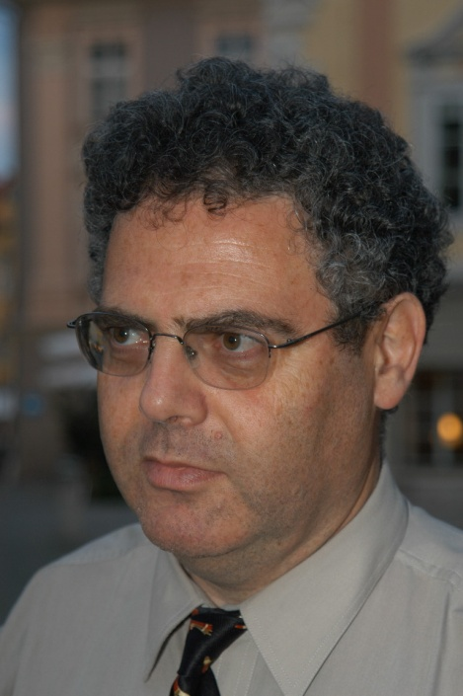
Bertrand Meyer
Bertrand Meyer, ISE California, ETH Zürich, Monash University Australia.
Designer of Eiffel programming language

Slide 35
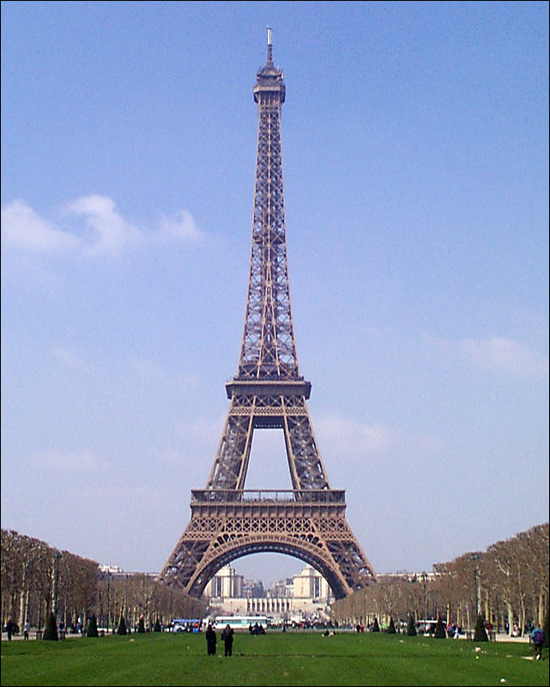
Eiffel: requires and results
requires for pre
results for post
Idea is exactly the same

Slide 36
Example: Airlines Reservation
Customer (Client Class)
Obligations:
Be at KLIA airport at least 1 hour before scheduled time
Bring acceptable baggage
Pay ticket price
Rights:
Reach Jakarta

Slide 37
Example: Airlines Reservation(cont.)
Airline (Supplier Class)
Obligations
Bring customer to Jakarta
Rights
- No need to carry passenger who is late, has unacceptable baggage or has not paid ticket

Slide 38
Pre and Post conditions + Invariants
Obligations are expressed via pre and post conditions
“If you promise to call me with the preconditions satisfied, then I, in return promise to deliver a final state in which the postcondition is satisfied”
Precondition: {x>=9} Postcondition: {x>=13}
component: {x:=x+5}

Slide 39
Pre and Post conditions + Invariants
Invariants
“For all calls you make to me, I will make sure the invariant remains satisfied.”
Invariant: {x>=y}
Precondition {x>0, y>0}
Component: {x:=x+y}

Slide 40
Contract: cleaning windows
‘Downstairs windows cleaned for £7’
Window cleaner (supplier of window-cleaning service)
Expectation:
Gets £7
Obligation:
Must clean downstairs windows
House-holder (client of window-cleaning service)
Expectation:
Gets clean downstairs windows
Obligation:
Must pay £7

Slide 41
Contract broken: home-delivery service
‘If you leave your garage door unlocked we will deliver your package’
Supplier: (delivery person)
Expectation:
finds garage door unlocked
Obligation:
Must leave package in (unlocked) garage
On client: (house-holder)
Expectation:
finds package in garage
Obligation:
Must leave garage door unlocked
No package? Whose fault?

Slide 42
Redundant Checks
Redundant checks: naïve way for including in the source code
public char pop() {
if (isEmpty (this)) {
… // Error-handling
} else {
…..}
This is redundant code: It is the responsibility of the client to ensure the precondition

Slide 43
New style (cleaner) style of programming
You have probably been taught to ‘test pre-conditions’, ‘check user input’, or similar, when writing a procedure.
With Design by Contract you never check the pre-condition, you assume it! It is the user’s (caller’s) obligation to ensure that the pre-condition is true.
Only exception: cannot assume end-user will type correct values

Slide 44
Contract Documentation
“A short form, which is stripped of all implementation information but retains the essential usage information: the contract … .” class interface DICTIONARY [ELEMENT] feature put (x: ELEMENT; key: STRING) is -- Insert x so that it will be retrievable -- through key. require count <= capacity not key.empty ensure has (x) item (key) = x count = old count + 1 ... Interface specifications of other features Invariant 0 <= count count <= capacity end -- class interface DICTIONARY

Slide 45
Example: automatic teller machine
Automatic teller machine (UK ‘cashpoint’)
Customer types-in PIN and amount wanted.
Software requires digits (0 .. 9) only.
How is this (pre-condition) ensured?
Only digits on keypad! (no letters)

Slide 46
Rationale
Not supplier’s problem!
Supplier cannot know what to do about it.
What value should be delivered if we write, for example:
sqrt(–4)?
Sometimes it takes longer to test the pre-condition than to do the task:
example, Binary Search test: O(n), search: O(log₂n)

Slide 47
Liberation!
Supplier does not have to decide (guess!) what to do when pre-condition not satisfied.
What do you think of this?
function Sqrt (x : real): real;
(* pre: x >= 0
post: abs(result * result – x) < eps *)
begin
if x < 0 then x := –x;
(* calculate square-root of x *)

Slide 48
No more arbitrary, ‘code’ values
What should be delivered by the top-of-stack function, when the stack is empty? By sqrt when the parameter is negative.
–1?
0?
Why?

Slide 49
Summary
Specifying with pre- and post-conditions concentrates on what is done, not how it is done.
Simple ‘formal’ method.
Design by contract makes clear the expectations and obligations on supplier and client of a service.
Liberates supplier of service from need to ‘guess’ what to do.

Slide 50
What is DBC?
Classes of a system communicate with one another on the basis of precisely defined benefits and obligations.
[Bertrand Meyer, CACM, Vol. 36, No 9, 1992]

Slide 51
What is DBC? (cont.)
Preconditions of methods
A boolean expression which is assumed true when the method gets called
Postconditions of methods
A boolean expression which the caller can assume to be true when the method returns
Class invariants
consistency conditions of objects must hold for all instances

Slide 52
Benefits of Design by Contract
Better understanding of software construction
Systematic approach to building bug-free oo systems
Effective framework for debugging, testing and quality assurance
Method for documenting software components
Better control of the inheritance mechanism
Technique for dealing with abnormal cases, effective exception handling

Slide 53
Rationale
A contract document protects both the client, by specifying how much should be done, and the supplier, by stating that the supplier is not liable for failing to carry out tasks outside of the specified scope
The obligations of the supplier become the benefits to the client

Slide 54
Rationale restated
a contract protects both sides:
Protects the client by specifying how much should be done; the client is entitled to receive a certain result
Protects the contractor by specifying how little is acceptable; the contractor must not be liable for failing to carry out tasks outside of the specified scope

